Slide 2
Specific learning Objectives
At the end of this presentation the learner is expected to know ;
Core areas* | Domain ** | Category #
Introduction | Cognitive | Must know
Method | Psychomotor | Must know
Armamentarium | Cognitive | Must know
*Subtopic of importance
** Cognitive, Psychomotor or Affective
# Must know , Nice to know & Desire to know
( Table to be prepared as per the above format )

Slide 3

CONTENTS
    Introduction
    Ideal requisites of die materials
    Classification of die materials
    Different die materials
    Different die systems
    Conclusion
    References

Slide 4
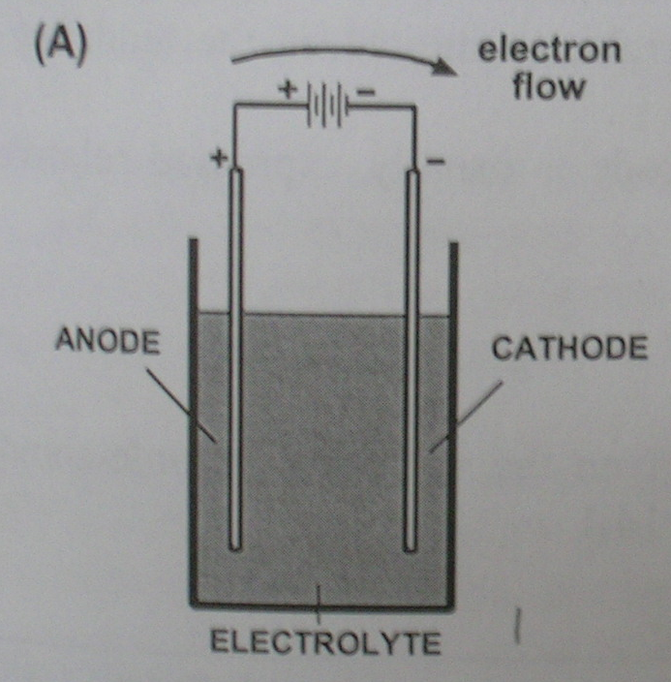
ELECTROLYTIC CELL

Slide 5
Because of their low energies, silicone impression materials are difficult to electroplate evenly.
Polyether impressions, because of their hydrophilic nature, imbibe water and become distorted.
Polysulfide polymers can be silver plated, but it is more difficult to copper plate them. The

Slide 6
The first step in the procedure is to treat the surface of the impression material so that it conducts electricity.
This process is referred to as METALLIZING.
In this process, a thin layer of metal, such as silver is deposited on the surface of the impression material.

Slide 7
Metallizing agents are :
Bronzing powder suspended in almond oil
Aqueous suspensions of silver powder
Powdered graphite
Requirements for electroplating :
The impression to be coated is made the cathode.

Slide 8
Anode is the metal to be deposited either silver or copper
Anode and cathode holder.
Electrolyte is the solution through which the electric current is passed.
The ions are deposited from the anode to the cathode.

Slide 9
COMPOSITION OF ELECTROPLATING BATH :
Copper :
Copper sulfate (crystals) – 200g
Sulfuric acid (concentrated) – 30 ml
Phenosulfonic acid – 2 ml
Water (distilled) – 1000 ml
Silver :
Silver cyanide – 36g
Potassium cyanide – 60 g
Potassium carbonate – 45g
Water (distilled) – 1000ml

Slide 10
AMMETER :- The current passed is of 10ma / tooth area for 12 hrs. It should not exceed 50ma.
Plating tank – glass or hard rubber with well fitting cover to prevent evaporation.

Slide 11
PROCEDURE :
a) Copper plating :
* The surface of the impression is rendered conductive by coating it with fine particles of copper or graphite.
* The coated impression is made the cathode (negative electrode) of a plating bath, with an anode (positive electrode) of copper.

Slide 12
* The electrolyte is an acid solution of copper sulfate (about 250g/l.
* A current is passed, causing slow dissolution of the anode and movement of copper ions from anode to cathode, so plating the impression.

Slide 13
Dental stone is then cast into the plated impression.
The technique is often not considered suitable for the elastomeric materials.
b) Silver plating :
Polysulfide and silicone impression materials can be silver plated by the same general technique except
The impression is coated with silver or graphite powder.
The anode is silver.
The electrolyte is an alkaline solution of silver cyanide

Slide 14
Problems in metal-forming : Due to
Faulty conduction
Exhausted solution
Over concentrated solution
Metal anode too small
Friable metal deposit

Slide 15
POLYMERIC MATERIALS :
Auto-polymerising acrylic : Although self-cure acrylic polymers are often recommended for use as die materials,
Disadvantages.
The monomer reacts with all except silicone impression materials.
The heat of reaction distorts thermoplastic materials.
There is a large percentage of monomer and the resultant volumetric contraction makes the material unsuitable as a die material.

Slide 16
FILLED POLYMERIC MATERIALS (EG. EPOXY RESINS, POLYESTERS AND EPIMINES)
Presentation : Some combination of liquids, pastes and powders.
Recently fast-setting epoxy materials have been supplied in automixing systems similar to those for automixing addition silicones.
Common brands : Diemet; goldex; impredur; polyroqq

Slide 17
DIE MATERIALS
 | Advantages | Disadvantages | Recommended use | Precautions
ADA type IV stone | 1)Dimensional accuracy 2)Straight forward technique 3)Low cost 4)Straight forward-in-office procedure | 1)Will be damaged if not handled carefully 2)Lower abrasion resistance | Most situations | 1)Accurate proportioning essential 2) Vacuum mix recommended
ADA type V stone | 1) Straight forward technique 2) Low cost 3) Straight forward in-office procedure 4) Harder than type IV | 1) Increased expansion | Most situations | 1)Accurate proportioning essential 2)Vacuum mix recommended

Slide 18
 | Advantages | Disadvantages | Recommended use | Precautions
Epoxy resin | 1) High strength 2) Good abrasion resistance | 1) Polymerization shrinkage 2) Time consuming complex procedure | Complete ceramic crowns | Not compatible with polysulfide and hydrocolloid
Electroplating | 1) High strength 2) Good abrasion resistance | 1) Time consuming 2) Special equipment needed | Complete ceramic crowns | Silver uses toxic cyanide. Incompatible with many impression materials.

Slide 19
“Study of the physical properties of type IV gypsum, resin-containing and epoxy die materials .” JPD 2000 Apr; 83 (4): 466-73.
All gypsum products expanded, whereas the epoxy resin material contracted during setting.
The epoxy resin exhibited much better detail reproduction, abrasion resistance and transverse strength than the gypsum materials.

Slide 20
A conventional type IV gypsum exhibited the highest surface hardness whereas the epoxy resin had the lowest value.
The resin-modified gypsum products were not significantly superior to the conventional type IV gypsum die materials.

Slide 21
Advantages :
Harder than die stone
May be used with all impression materials
Detail is good

Slide 22
* Shrinkage on setting, loss of water on standing.
* It is a rather brittle material and readily fractured in thin sections.
Disadvantage

Slide 23
CERAMIC DIE MATERIALS :
Two ceramic die materials are available :
  To form the dies heating to over 1000⁰C is necessary.
  Fired at 600⁰C for 8 minutes to produce a hard strong die.
Common brands : Ceramite H &V, Ducera-Lay,

Slide 24
TAKE HOME MESSEGE/ FOR THE TOPIC COVERED (SUMMARY)
The ease with which a restoration is fabricated and the accuracy with which it will fit the mouth is materially affected by the casts and dies.
So a die material should be selected that has
Good dimensional accuracy,
Abrasion resistance and
Ability to reproduce fine detail and sharp margins.

Slide 25
Question & Answer Session
Write in brief about die preparation.
Write a short note on dowel pins.
Write a short note on die stone.
Write in brief ideal requirements of die materials.

Slide 26
REFERENCES
Johnston’s – Modern practice in fixed prosthodontics.
Dental materials- Properties and manipulation – Craig, Obrein, Powers, 5th Edition.
Restorative dental materials – Robert, G. Craig and John H. Powers, 11th Edition.
Anusavice - Phillips Sciences of Dental materials, 10th Edition.
Contemporary fixed prosthodontics – Stephen F. Rosenstiel – 3rd Edition.
IJP 2000 Vol 13, No: 3 pp: 214-20.
JPD 2000 Apr; Vol 83 No: 4 pp: 466-73.
JPD 2000 Mar; Vol 83 No. 3 pp: 301-5.
JPD 1998 Oct; Vol 80 No. 4 pp: 485-9.

Slide 27
THANK YOU

